Slide 1




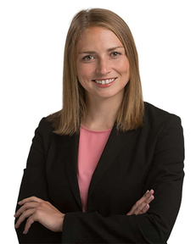

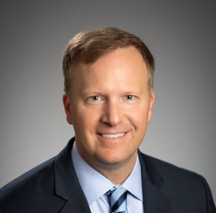
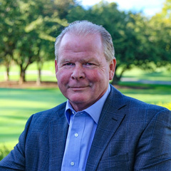
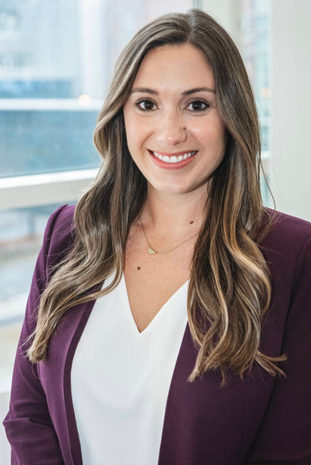

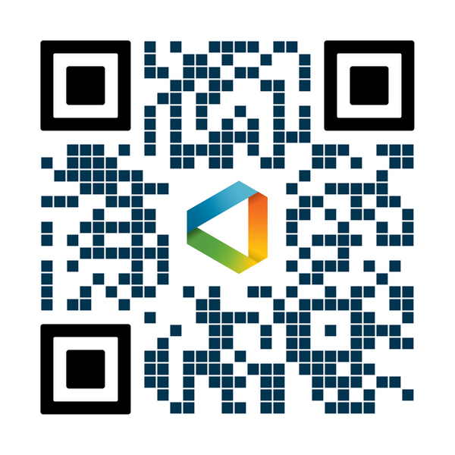




OneDigital Financial Academy
Q1 2025: UPCOMING WEBINARS
Allie Rivera, CFA
VP of Investments and Retirement Services
OneDigital Financial Services
Jon Higham
Employee Engagement Manager
OneDigital Financial Services
Jerry Lynch, CFP®, CLU, ChFC
Senior Vice President
OneDigital Financial Services
Amy Todd, CPFA®
Senior Retirement Plan Consultant
OneDigital Financial Services
Strategies to Conquer Your Debt in The New Year
How Today's Headlines May Influence Your Taxes
A Women's Guide to Smart Investing
Jan. 14th - 2 p.m. CST
Feb. 11th - 2 p.m. CST
March 11th - 2 p.m. CST
Register
Register
Register
This webinar provides practical strategies to manage and reduce debt, helping you kick off the new year with a stronger financial foundation. We will cover actionable steps to take control of your finances, reduce high-interest debts, and build a sustainable cash-flow.
Join us as we explore how current events and policy changes impact your taxes. Senior Vice President, Jerry Lynch will provide insights on how recent headlines may affect your tax and financial planning to help you stay informed and prepared.
Join some of the amazing OneDigital Women as they demystify the world of investments. This special edition session, aims to shift the mindset from fear and uncertainty to wealth-building action, empowering you to take charge of your financial future.
Looking for additional financial education and webinars? Check out our full Financial Academy:
onedigital.com/financial-academy/
Investment advice offered through OneDigital Investment Advisors LLC.

